Slide 1
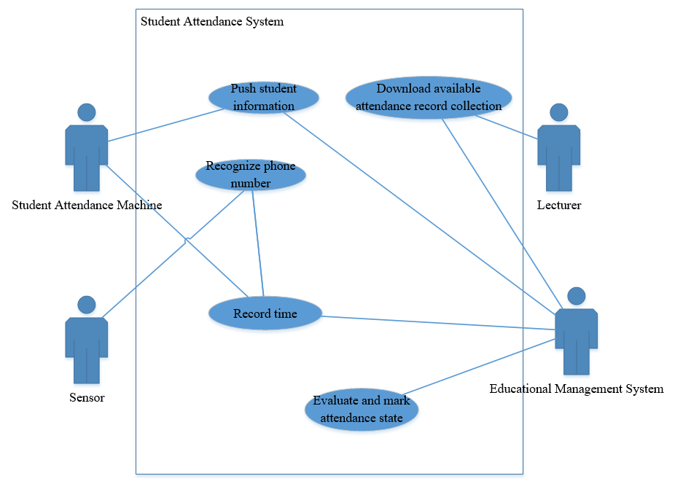
‘Student Attendance System’ use cases

Slide 2
Use case name: | Recognize Phone Number
Scope: | Student Attendance System
Primary actor: | Sensor
Secondary actors: | None
Summary: | Sensor intends to recognize the phone number passing the door within a limited range
Preconditions: | 1. Each door of every classroom is installed a sensor 2. Every student has phone number
Main success scenario: | Students pass door with phone number. Sensor recognizes phone number within a limited range Sensor records phone number
Alternatives: | 3a. Seneor records phone number type
Exceptions: | 2a: Phone number is broken and can’t be recognized
Postconditions: | Phone number is recognized by Sensor

Slide 3
Use case name: | Record Time
Scope: | Student Attendance System
Primary actor: | Student Attendance Machine
Secondary actors: | Educational Management System
Summary: | Student Attendance Machine intends to record the arriving time and departure time of each phone number and then pass them to the Educational Management System
Preconditions: | Sensor has recogized every phone number
Main success scenario: | Sensors send phone number to student attendance machine Student attendance machine receives phone number and record the arriving time and departure time of each phone number according timetable. Student attendance machine passes related information to the educational management system
Alternatives: | 3a.Educational management system backs up the data
Exceptions: | 3a. The capacity of educational management system is full. It can’t accept anymore information.
Postconditions: | The arriving time and departure time of each phone number are paseds to the educational management system

Slide 4
Use case name: | Evaluate and mark attendance state
Scope: | Student Attendance System
Primary actor: | Educational Management System
Secondary actors: | None
Summary: | Educational Management System intends to evaluate and mark the attendance state of each involved student
Preconditions: | Educational Management System has student attendance information
Main success scenario: | Educational Management System extracts student attendance information from database Educational Management System evaluates and marks the attendance state of each involved student that including: Normal, Absent, Leave early. Educational Management System stores evaluation result
Alternatives: | 3a. Educational Management System deletes origion student attendance information after evaluation
Exceptions: | 1a. The student attendance information isn’t complete
Postconditions: | Attendance state of each involved student is evaluated and marked

Slide 5
Use case name: | Download attendance record
Scope: | Student Attendance System
Primary actor: | Lecturer
Secondary actors: | Educational Management System
Summary: | Lecturer wishes to download attendance record
Preconditions: | Lecturer is logged in Educational Management System
Main success scenario: | Lecturer chooses the expected attendance record Educational Management System returns the result Lecturer downloads available attendance record at any time
Alternatives: | 1a. Lecturer uses keywords to chooses the expected attendance record
Exceptions: | 2a. Educational Management System returns more than one result
Postconditions: | Attendance record is downloaded by Lecturer

Slide 6
Use case name: | Push Student Information
Scope: | Student Attendance System
Primary actor: | Educational Management System
Secondary actors: | Student Attendance Machine
Summary: | Educational Management System pushes student information to Student Attendance Machine
Preconditions: | Educational Management System has student information
Main success scenario: | Educational Management System requires to connect Student Attendance Machine Student Attendance Machine agrees to be connected and responses According to timetable, educational management system pushes the student information including the student list and corresponding phone number to student attendance machine
Alternatives: | 1a. Educational Management System directly pushes student information to Student Attendance Machine without inquiry. Go to 3
Exceptions: | 2a. Student Attendance Machine disagrees to be connected
Postconditions: | Student Attendance Machine receives stuednt information

